Slide 1
20XC15 -Problem Solving and C Programming

Slide 2
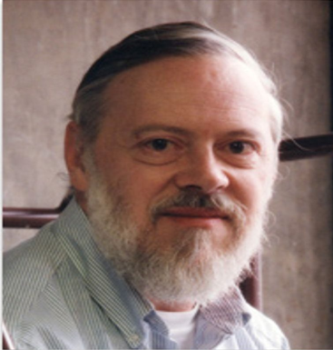
History of C
Originally developed in the 1970’s by Dennis MacAlistair Ritchie at Bell Telephone Laboratories, Inc. (part of AT&T Company)
Evolved from two previous programming languages, BCPL and B in Bell Labs.
Many of its principles and ideas were taken from the earlier language B and B's earlier ancestors BCPL and CPL
Used to develop UNIX and modern operating systems
  Many of todays leading operating systems are written in C and/or C++

Slide 3
History of C
C is mostly hardware independent - With careful design, it’s possible to write C programs that are portable to most computers
Standardization
  Many slight variations of C existed, and were incompatible
  In 1983, the American National Standards Institute ( ANSI ) formed a committee to establish a standard definition of C which became known as ANSI Standard C

Slide 4
Why learn C?
A number of programming languages in the world today
  C++, Java, Ada, Basic, COBOL, Perl, Pascal, Smalltalk, FORTRAN, etc. and other higher level languages that provide much larger built-in libraries
Reasons to learn C
  a common language in the world today
  a simple and small language - with 32 keywords
  a stable language
    The ANSI standard for C was created in 1983. The language has not been revised since then. In newer languages, the standard changes regularly and often, so a good code written today may not compile properly tomorrow.

Slide 5
Why learn C?
  programs written in C are very efficient and fast
    due to its variety of data types and powerful operators
    a well-written C program is likely to be as quick as a well-written program in any other high-level language
  a powerful and flexible language which helps system developers to deliver various complex tasks with ease
    used for developing diverse projects as operating systems, word processors, graphics, spreadsheets, and even compilers for other languages
  a core language
    a number of common and popular languages are based on C
  a portable language
    means that a C program written for one computer system (an IBM PC, for example) can be run on another system (a DEC VAX system, perhaps) with little or no modification

Slide 6
Why learn C?
  has ability to extend itself
    a C program is basically a collection of various functions supported by C library (also known as header files)
    we can also add our own functions to the C library
    these functions can be reused in other applications or programs by passing pieces of information to the functions, thus creating useful & reusable code
These features shows that C is an excellent choice for your first programming language
Having learnt C, it will be much easier to learn languages that are largely or in part based upon C
  like C++, Java, and Perl

Slide 7
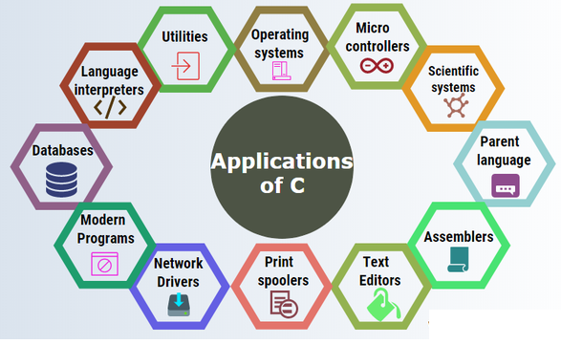
Areas of Application
    https://www.toptal.com/c/after-all-these-years-the-world-is-still-powered-by-c-programming

Slide 8
Importance of learning C as a Cybersecurity Professional
Most servers in MNCs use Unix/Linux, which are almost completely written in C.
  You need to have C programming knowledge, to understand how the Unix/Linux OS works in order to protect servers from hackers.
    Because they provide access to low-level IT infrastructure like RAM and system processes, which if not protected, hackers can easily exploit.
  Even the Android OS used in mobile phones which are vulnerable to attacks is based on Linux (Unix – like family of OS)

Slide 9
Typical C Program Development Environment
C programs typically go through six phases to be executed.
These are
  Edit
  Preprocess
  Compile
  Link
  Load
  Execute

Slide 10
Typical C Program Development Environment
Phase 1 consists of editing a file
This is accomplished with an editor program
Two editors widely used on Linux systems are vi and nano
Software packages for the C/C++ integrated program development environments such as Codeblocks and Microsoft Visual Studio have editors that are integrated into the programming environment
We type a C program with the editor, make corrections if necessary, then store the program on a secondary storage device such as a hard disk
C program file names should end with the .c extension

Slide 11
Typical C Program Development Environment
In Phase 2, provide the command to compile the program
The compiler translates the C program into machine language-code (also referred to as object code)
In a C system, a preprocessor program executes automatically before the compiler’s translation phase begins
It indicates that certain manipulations are to be performed on the program before compilation
  These manipulations usually consist of including other files in the file to be compiled and performing various text replacements

Slide 12
Typical C Program Development Environment
In Phase 3, the compiler translates the C program into machine-language code
A syntax error occurs when the compiler cannot recognize a statement because it violates the rules of the language.
Syntax errors are also called compile-time errors
Older compilers (gcc compiler), generate assembly code before converting into machine code.

Slide 13
Typical C Program Development Environment
The next phase (Phase 4) is called linking
C programs typically contain references to functions(printf) defined elsewhere, such as in the standard libraries(stdio.h) or in the private libraries of groups of programmers working on a particular project
A linker links the object code with the code for the missing functions to produce an executable image (with no missing pieces)

Slide 14
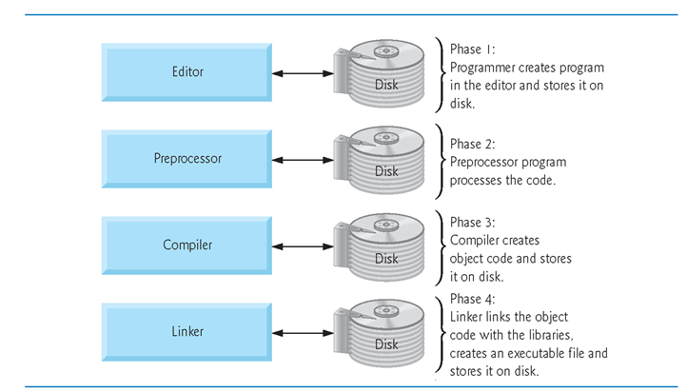
Typical C Program Development Environment

Slide 15
Typical C Program Development Environment
The fifth phase is called loading
Before a program can be executed, the program must first be placed in primary memory
  This is done by the loader, which takes the executable image from disk and transfers it to the primary memory
Finally, the computer, under the control of its CPU, executes the program one instruction at a time

Slide 16
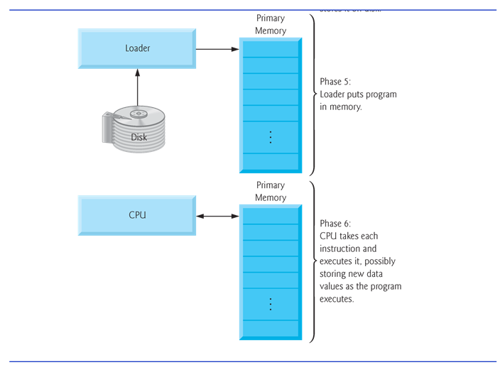
Typical C Program Development Environment

Slide 17
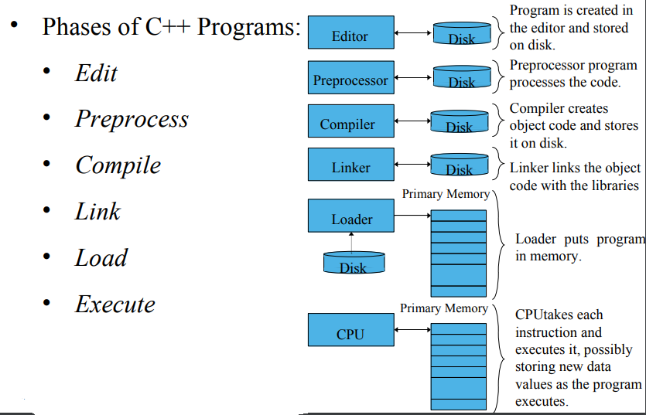
Six Phases – C Program Development Environment

Slide 18
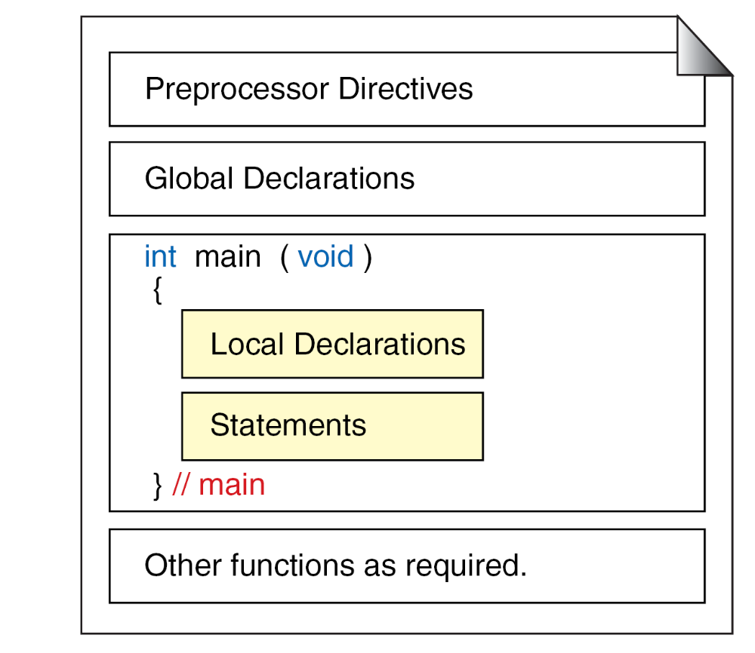
Structure of a C Program

Slide 19
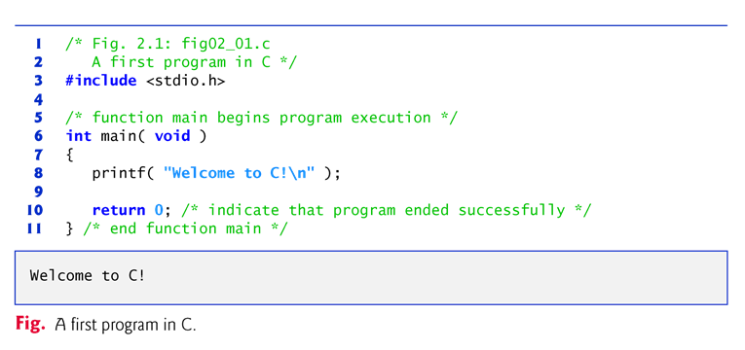
A Simple C Program

Slide 20
A Simple C Program
Lines 1 and 2
    /* Fig. 2.1: fig02_01.c
    A first program in C */
Begin with /* and end with */ indicating that these two lines are a comment
Comments - to document programs and improve program readability
Comments do not cause the computer to perform any action when the program is run
Comments are ignored by the C compiler and do not cause any machine-language object code to be generated
Comments also help other people read and understand your program

Slide 21

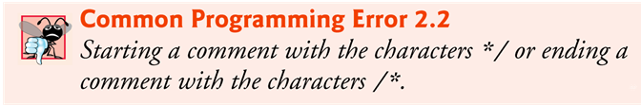
A Simple C Program
Common Programming Errors

Slide 22
A Simple C Program
// single-line comments
  Everything from // to the end of the line is a comment
  These can be used as standalone comments on lines by themselves or as end-of-line comments to the right of a partial line of code
  Some programmers prefer // comments because they’re shorter and they eliminate the common programming errors that occur with /* */ comments

Slide 23
A Simple C Program
Line 3
  #include <stdio.h>
is a directive to the C preprocessor
Lines beginning with # are processed by the preprocessor before the program is compiled.
Line 3 - tells the preprocessor to include the contents of the standard input/output header (<stdio.h>) in the program
This header contains information used by the compiler when compiling calls to standard input/output library functions such as printf

Slide 24
The Standard C Library
A programmer can create his own functions
  Advantage: the programmer knows exactly how it works
  Disadvantage: time consuming
Programmers will often use the C library functions
  Use these as building blocks
Avoid re-inventing the wheel
  If a premade function exists, generally best to use it rather than write your own
  Library functions carefully written, efficient, and portable

Slide 25
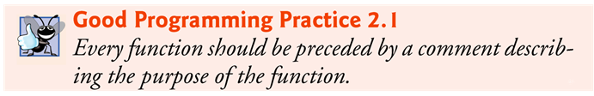
A Simple C Program
Line 6
    int main( void )
is a part of every C program.
The parentheses after main indicate that main is a program building block called a function
C programs contain one or more functions, one of which must be main.
Every program in C begins executing at the function main
The keyword int to the left of main indicates that main “returns” an integer (whole number) value
The void in parentheses here means that main does not receive any information

Slide 26
A Simple C Program
A left brace, {, begins the body of every function (line 7).
A corresponding right brace ends each function (line 11).
This pair of braces and the portion of the program between the braces is called a block.
Line 8
    printf( "Welcome to C!\n" );
instructs the computer to perform an action, namely to print on the screen the string of characters marked by the quotation marks.
A string is sometimes called a character string, a message or a literal.

Slide 27
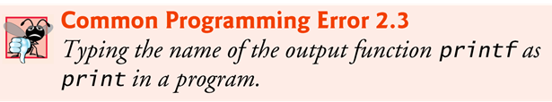
A Simple C Program
The entire line, including printf, its argument within the parentheses and the semicolon (;), is called a statement
Every statement must end with a semicolon (also known as the statement terminator)
When the preceding printf statement is executed, it prints the message Welcome to C! on the screen
The characters normally print exactly as they appear between the double quotes in the printf statement

Slide 28
A Simple C Program
Notice that the characters \n were not printed on the screen
When encountering a backslash in a string, the compiler looks ahead at the next character and combines it with the backslash to form an escape sequence
The escape sequence \n means newline.
When a newline appears in the string output by a printf, the newline causes the cursor to position to the beginning of the next line on the screen

Slide 29
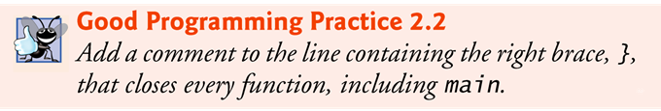
A Simple C Program
Line 10
    return 0; /* indicate that program ended successfully */
is included at the end of every main function.
The keyword return is one of several means we’ll use to exit a function.
When the return statement is used at the end of main as shown here, the value 0 indicates that the program has terminated successfully.
The right brace, }, (line 12) indicates that the end of main has been reached.

Slide 30
A Simple C Program
Standard library functions like printf and scanf are not part of the C programming language.
  For example, the compiler cannot find a spelling error in printf or scanf
When the compiler compiles a printf statement, it merely provides space in the object program for a “call” to the library function
But the compiler does not know where the library functions are – but the linker does
When the linker runs, it locates the library functions and inserts the proper calls to these library functions in the object program

Slide 31
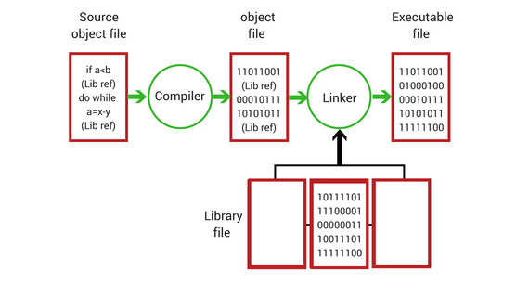
A Simple C Program
Now the object program is complete and ready to be executed
For this reason, the linked program is called an executable
If the function name is misspelled, it’s the linker that will spot the error, because it will not be able to match the name in the C program with the name of any known function in the libraries

Slide 32
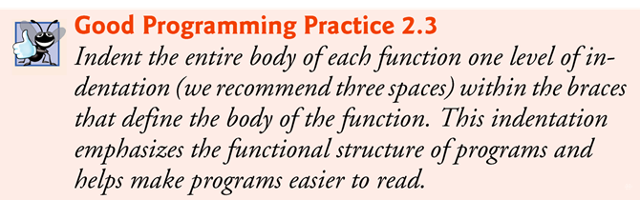
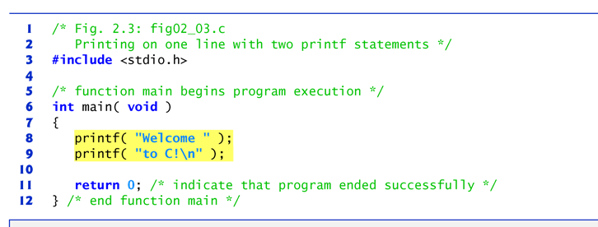
A Simple C Program

Slide 33
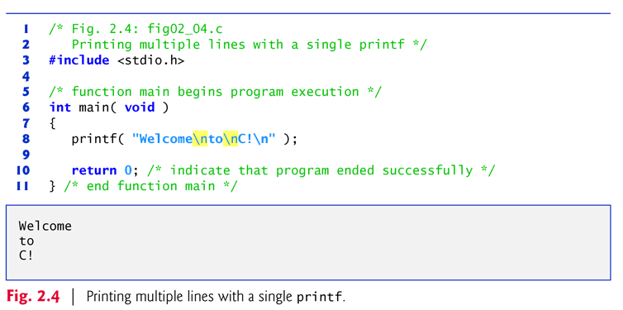
A Simple C Program
One printf can print several lines by using additional newline characters as in Fig. 2.4.
Each time the \n (newline) escape sequence is encountered, output continues at the beginning of the next line.

Slide 34
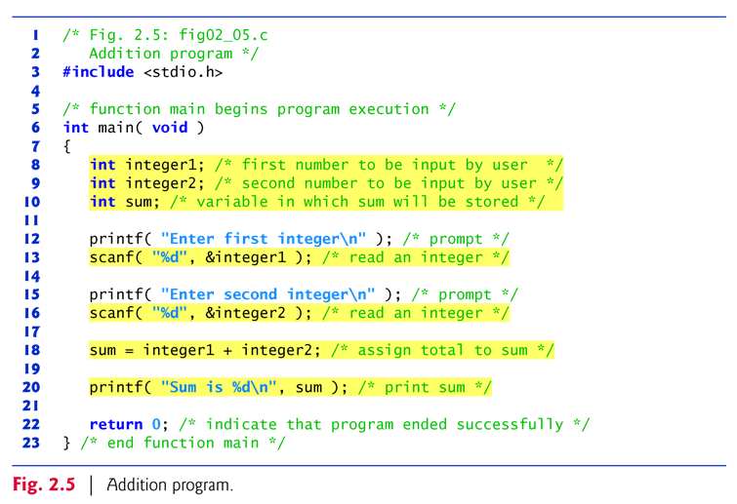
Another Simple C Program – Addition of Two Integers

